Slide 2
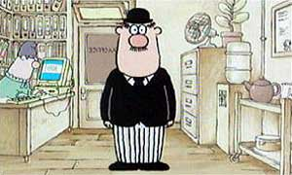
Meet this gentleman!!!
He is struggling with … a problem
He is a derivative trader.

Slide 3
Meet this gentleman!!!
He want to buy gold @ 50000 but he is afraid that the prices may fall after buying
He is a derivative trader.

Slide 4

Buy a call option
Teacher

Slide 5
After this he was very happy

Slide 6
After some time……

Slide 7

After some time……

Slide 8


Slide 9


Slide 10

He is still upset

Slide 11

At what price

Slide 12


Pricing of options is not easy

Slide 13

Which model is better binominal or BSM

Slide 14
OPTION PRICING

Slide 15
The Binomial Model

Slide 16
A Simple Model to Value Options Before Expiration
Suppose we want to know the price of a call option with
One year to maturity.
A $110 exercise price.
The current stock price is $108.
The one-year risk-free rate, r, is 10 percent.
We know (somehow) that the stock price will be $130 or $115 in one year.
We know that the stock price is going to be $130 or $115 (but no other values).we do not know the probabilities of these two values.
The stock price in one year is still uncertain.

Slide 17
130
_{Profit in call = 20}
_{Profit in put = 0}
One year
S = 108
Κ = 110
One year
115
_{Profit in call = 5}
_{Profit in put = 0}
Value Today
Value At Expiration

Slide 18
A Simple Model to Value Options Before Expiration
This call option is certain to finish in the money.
A similar put option is certain to finish out of the money.

Slide 19
A Simple Model to Value Options Before Expiration
You can use put-call parity to price a call option before it expires.

Slide 20
A Simple Model to Value Options Before Expiration
The chosen pair of stock prices guarantees that the call option finishes in the money.
Suppose, we want to allow the call option to expire in the money OR out of the money.
How do we proceed in this case?
Well, we need a different option pricing model.

Slide 21
The Binomial Model
The model assumes,
The price of asset can only go up or go down in fixed amounts.

Slide 22
The One-Period Binomial Option Pricing Model—The Assumptions
Suppose the stock price today is S, and the stock pays no dividends.
We assume that the stock price in 1 period is either S × u or S × d, where:
u (for “up” factor) is bigger than 1
d (for “down” factor) is less than 1

Slide 23
The One-Period Binomial Option Pricing Model—The Assumptions
Suppose the stock price today is $100, and u = 1.1 and d = .95.
The stock price in one period will either be
$100 × 1.1 = $110
or
$100 × .95 = $95.
What is the call price today, if:
K = 100
r = 3%

Slide 24
The One-Period Binomial Option Pricing Model—The Setup
Make a Portfolio:
Buy a fractional share of the underlying asset
Sell 1 call option
Finance the difference by borrowing the amount: DS – C
Key Question: What is the value of this portfolio, today and at option expiration?

Slide 25
The Value of this Portfolio (long D Shares and short 1 call) is:
Important: DS is NOT the change in S.
Rather, it is a dollar amount, DS.
DS×u - C_{u}
C_{u} and C_{d} : The intrinsic value of the call if the stock price increases to S×u or decreases to S×d.
DS - C
DS×d - C_{d}
Portfolio Value Today
Portfolio Value At Expiration

Slide 26
To Calculate Today’s Call Price, C:
A Brilliant Insight: To makes this portfolio risk-less.
The portfolio is : DSu – C_{u} = DSd – C_{d}
To make the portfolio riskless: DSu – C_{u} = DSd – C_{d}
DSu – DSd = C_{u} – C_{d}
D(Su – Sd) = C_{u} – C_{d,}
D = C_{u} – C_{d}/(Su – Sd)

Slide 27
Therefore, Our First Step is to Calculate D
We know all values in this equation today, except D.
DSu – C_{u} = DSd – C_{d}
S = $100;
C_{u} = MAX(Su – K, 0) = MAX($110 – 100,0) = $10.
C_{d} = MAX(Sd – K, 0) = MAX($95 – 100,0) = $0.
Therefore, we can calculate D:
D = (C_{u} – C_{d}) / (Su – Sd)
D = (10 – 0) / 110 – 95
D = 10 / 15
D = 2 / 3.
Su = $110
Sd = $95

Slide 28
That means you have to buy 2/3 shares to sell 1 call if you want to earn risk free profit

Slide 29
What is D?
D is delta.
D, delta, is the fractional share amount needed to hedge one call.
Therefore, the number of calls to hedge one share is 1/D.

Slide 30
The One-Period Binomial Option Pricing Model—The Formula
A riskless portfolio today should be worth (DS – C)(e^{rt}) in one period.
So, (DS – C)e^{rt} = DSu – C_{u}
(which equals DSd – C_{d} because we chose the “correct” D).
Solving the equation above for C:

Slide 31
The One-Period Binomial Option Pricing Model—The Formula
A riskless portfolio today should be worth (DS – C)(e^{rt}) in one period.
So, (DS – C)e^{rt} = DSu – C_{u}
(which equals DSd – C_{d} because we chose the “correct” D).
Solving the equation above for C:

Slide 32
The One-Period Binomial Option Pricing Model—The Formula
A riskless portfolio today should be worth (DS – C)(e^{rt}) in one period.
So, (DS – C)e^{rt} = DSu – C_{u}
(which equals DSd – C_{d} because we chose the “correct” D).
Solving the equation above for C:

Slide 33
The One-Period Binomial Option Pricing Model—The Formula
A riskless portfolio today should be worth (DS – C)(e^{rt}) in one period.
So, (DS – C)e^{rt} = DSu – C_{u}
(which equals DSd – C_{d} because we chose the “correct” D).
Solving the equation above for C:

Slide 34
The One-Period Binomial Option Pricing Model—The Formula
A riskless portfolio today should be worth (DS – C)(e^{rt}) in one period.
So, (DS – C)e^{rt} = DSu – C_{u}
(which equals DSd – C_{d} because we chose the “correct” D).
Solving the equation above for C:

Slide 35
The One-Period Binomial Option Pricing Model—The Formula
A riskless portfolio today should be worth (DS – C)(e^{rt}) in one period.
So, (DS – C)e^{rt} = DSu – C_{u}
(which equals DSd – C_{d} because we chose the “correct” D).
Solving the equation above for C:

Slide 36
The One-Period Binomial Option Pricing Model—The Formula

Slide 37
Now We Can Calculate the Call Price, C.
What is the price of a similar put?
Using Put-Call Parity:
Why can we use Put-Call Parity?

Slide 38
Binomial with Probability
As of now we did not use probability in binominal. But we also can use probability.
Binominal diagram representing different possible paths that might be followed by the stock price over the life of an option.
The underlying assumption is that the stock price follows a random walk.
In each time step, it has a certain probability of moving up by a certain percentage amount and a certain probability of moving down by a certain percentage amount.

Slide 39
A ONE-STEP BINOMIAL MODEL
We start by considering a very simple situation
A stock price is currently $20,
Expiry in 3 months
It will be either $22 or $18. (as we know binominal case)

Slide 40
22
S = 20
= 21
Τ = 3Μ
18
Value Today
Value At Expiration

Slide 41
We want to know what should be the price of call option today
22
_{Profit in call = 1}
S = 20
= 21
Τ = 3 Μ
18
_{Profit in call = 0}
Value Today
Value At Expiration

Slide 42
A ONE-STEP BINOMIAL MODEL AND A NO-ARBITRAGE ARGUMENT
Consider a portfolio consisting of a long position in D shares of the stock and a short position in 1 call option
We calculate the value of D that makes the portfolio riskless.

Slide 43
A ONE-STEP BINOMIAL MODEL AND A NO-ARBITRAGE ARGUMENT
If the stock price moves up from $20 to $22, the
Value of the portfolio is 22D — 1.
If the stock price moves down from $20 to $18,
Value of the portfolio is 18D - 0.
The portfolio is riskless if the value of D is chosen in such a way so that the final value of the portfolio is the same for both alternatives.

Slide 44
A ONE-STEP BINOMIAL MODEL AND A NO-ARBITRAGE ARGUMENT
If final value of the portfolio is the same for both alternatives.
22D — 1 = 18D
D = .25
A riskless portfolio is therefore
Long: 0.25 shares or 1 shares
Short: 1 option or 4 options

Slide 45
A ONE-STEP BINOMIAL MODEL AND A NO-ARBITRAGE ARGUMENT
If the stock price moves up to $22,
The value of the portfolio is 22 >< 0.25 — 1 = 4.5
If the stock price moves down to $18,
The value of the portfolio is 18 >< 0.25 = 4.5

Slide 46
A ONE-STEP BINOMIAL MODEL AND A NO-ARBITRAGE ARGUMENT
Riskless portfolios must, in the absence of arbitrage opportunities, earn the risk-free rate of interest.
Suppose that, in this case, the risk-free rate is 12% per annum.
Portfolio today present value of 4.5 is 4.5e^{-.12><3/12} = 4.367
Stock price is $20. Suppose the option price is denoted by f.
The value of the portfolio today is
20><0.25 – f = 4.367
f = 0.633

Slide 47
A Generalization
We can generalize the no-arbitrage argument just presented by considering
A stock whose price is S₀
An current option Premium is f.
Stock price can either move up from S₀ ,
S₀ u, where u > 1,
Down from S₀ to a new level
S₀ d, where d < 1.
If the stock price moves up to S₀ u,
Payoff from the option is fu
If the stock price moves down to S₀ d
Payoff from the option is fd.

Slide 48
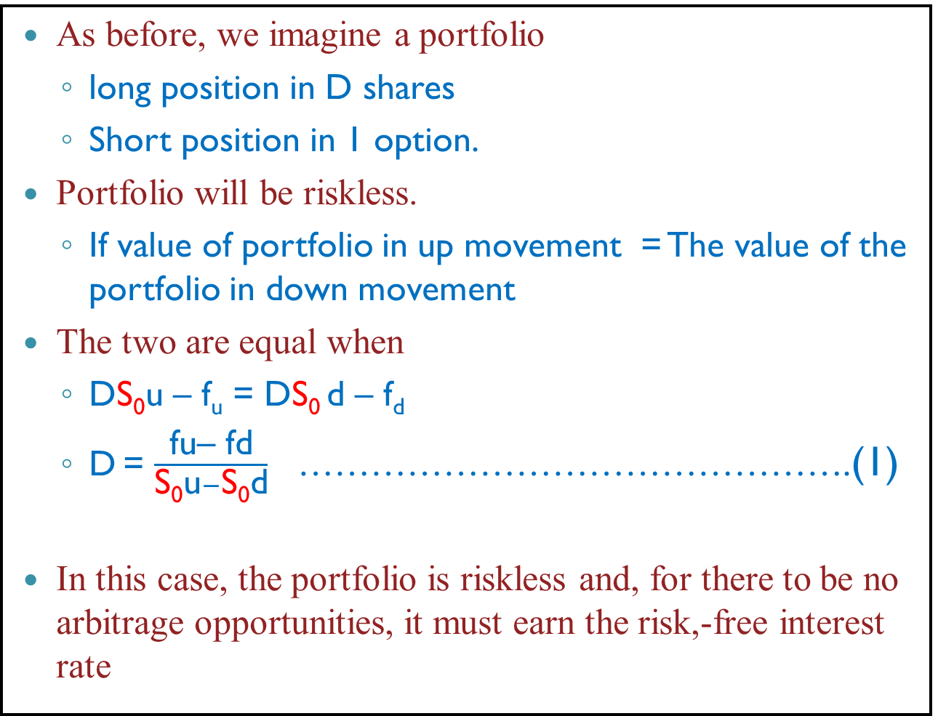
A Generalization
As before, we imagine a portfolio
long position in D shares
Short position in 1 option.
Portfolio will be riskless.
If value of portfolio in up movement = The value of the portfolio in down movement
The two are equal when
DS₀u – f_{u} = DS₀ d – f_{d}
D= $\frac{\text{fu}\text{– }\text{fd}}{\text{S}\text{0}\text{u}−\text{S}\text{0}\text{d}}$ ……………………………………….(1)
In this case, the portfolio is riskless and, for there to be no arbitrage opportunities, it must earn the risk,-free interest rate

Slide 49
A Generalization
If we denote the risk-free interest rate by r,
The present value of the portfolio is
(DS₀u – f_{u}) e^{-rt}
The cost of setting up the portfolio is
DS₀ – f
Cost of the portfolio should be equal to PV of future cash flow of portfolio
DS₀ – f = (DS₀u – f_{u}) e^{-rt}
- f = (DS₀u – f_{u}) e^{-rt} - DS₀
f = DS₀ (1-ue^{-rt} ) + f_{u}e^{-rt} ……………………….(2)

Slide 50
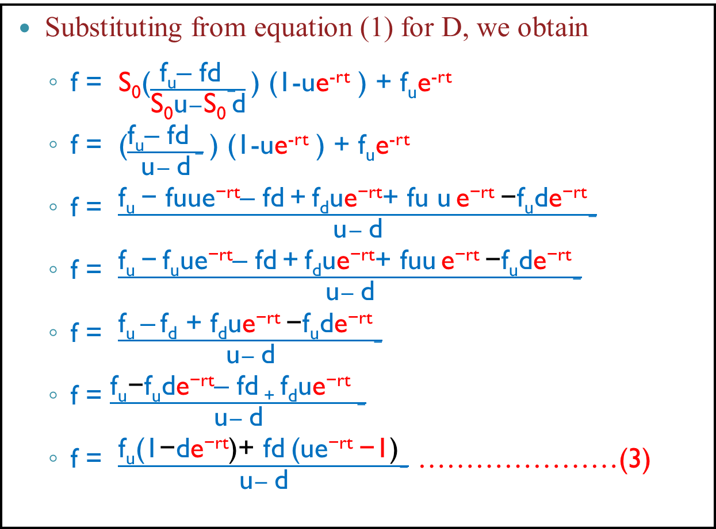
A Generalization
Substituting from equation (1) for D, we obtain
f = S₀($\frac{\text{f}\text{u}\text{– }\text{fd} −}{\text{S}\text{0}\text{u}−\text{S}\text{0 }\text{d}}$) (1-ue^{-rt} ) + f_{u}e^{-rt}
f =($\frac{\text{f}\text{u}\text{– }\text{fd} −}{\text{u}− \text{d}}$) (1-ue^{-rt} ) + f_{u}e^{-rt}
f =$\frac{\text{f}\text{u} \text{− }\text{fuue}\text{−}\text{rt}\text{– }\text{fd} \text{+} \text{f}\text{d}\text{u}\text{e}\text{−}\text{rt}\text{+ }\text{fu} \text{u} \text{e}\text{−}\text{rt} \text{−}\text{f}\text{u}\text{d}\text{e}\text{−}\text{rt}−}{\text{u}− \text{d}}$
f =$\frac{\text{f}\text{u}\text{ − }\text{f}\text{u}\text{ue}\text{−}\text{rt}\text{– }\text{fd} \text{+} \text{f}\text{d}\text{u}\text{e}\text{−}\text{rt}\text{+ }\text{fuu} \text{e}\text{−}\text{rt} \text{−}\text{f}\text{u}\text{d}\text{e}\text{−}\text{rt}−}{\text{u}− \text{d}}$
f =$\frac{\text{f}\text{u}\text{ – }\text{f}\text{d}\text{ + }\text{fdue}\text{−}\text{rt} \text{−}\text{f}\text{u}\text{d}\text{e}\text{−}\text{rt}−}{\text{u}− \text{d}}$
f =$\frac{\text{f}\text{u}\text{−}\text{f}\text{u}\text{d}\text{e}\text{−}\text{rt}\text{– }\text{fd}\text{ + }\text{f}\text{d}\text{u}\text{e}\text{−}\text{rt} −}{\text{u}− \text{d}}$
f =$\frac{\text{f}\text{u}\text{(1}\text{−}\text{d}\text{e}\text{−}\text{rt}\text{)+} \text{fd} \text{(}\text{ue}\text{−}\text{rt} \text{−1}\text{)}−}{\text{u}− \text{d}}$ …………………(3)

Slide 51
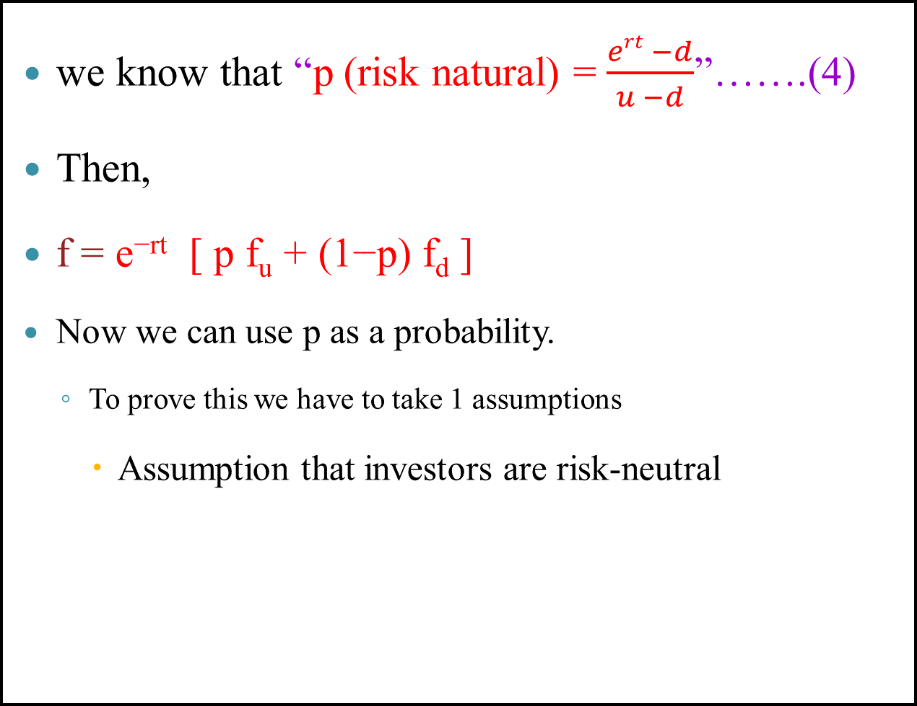
A Generalization
we know that “p (risk natural) = $\frac{ert −d}{u −d}$”…….(4)
Then,
f =$\text{e}\text{−}\text{rt} \text{[} \text{p} \text{f}\text{u}\text{ +} \text{(1−}\text{p}\text{) }\text{fd}$ ]
Nowwe can use p as a probability.
To prove this we have to take 1 assumptions
Assumption that investors are risk-neutral

Slide 52
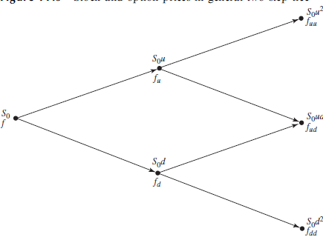
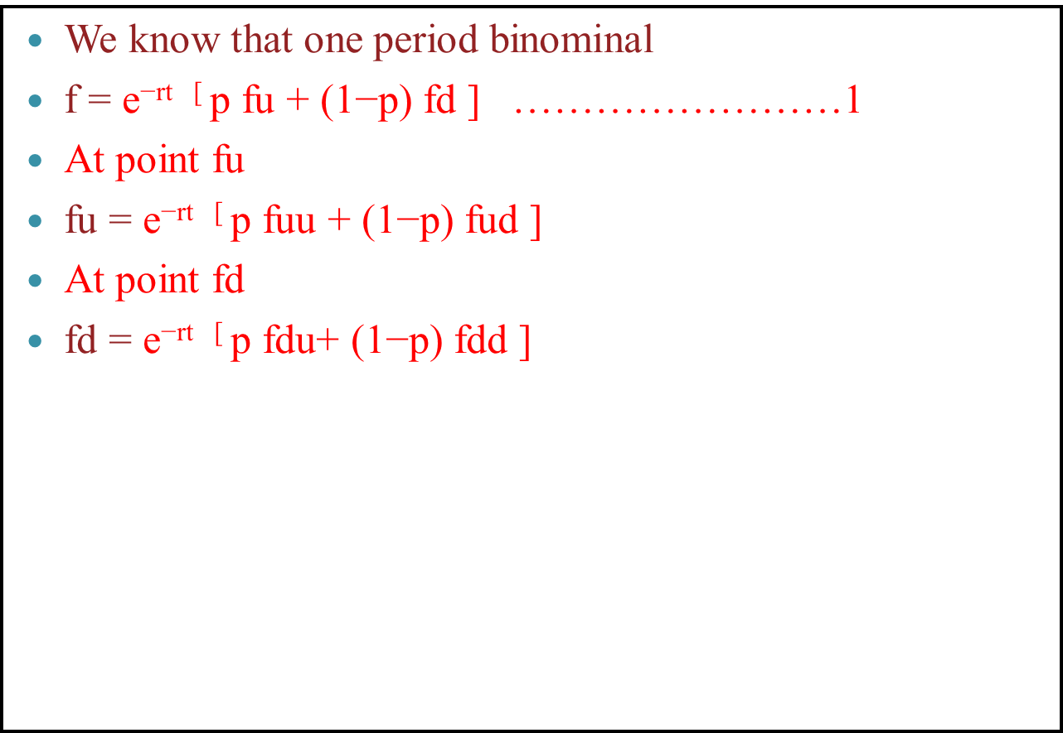
The Two-Period Binomial Option Pricing Model
We know that one period binominal
f =$\text{e}\text{−}\text{rt}\text{ [ }\text{p} \text{fu}\text{ + (1−}\text{p}\text{) }\text{fd}$ ] ……………………1
At point fu
fu = $\text{e}\text{−}\text{rt}\text{ [ }\text{p} \text{fuu}\text{ + (1−}\text{p}\text{) }\text{fud}$ ]
At point fd
fd = $\text{e}\text{−}\text{rt}\text{ [ }\text{p} \text{fdu}\text{+ (1−}\text{p}\text{) }\text{fdd}$ ]

Slide 53
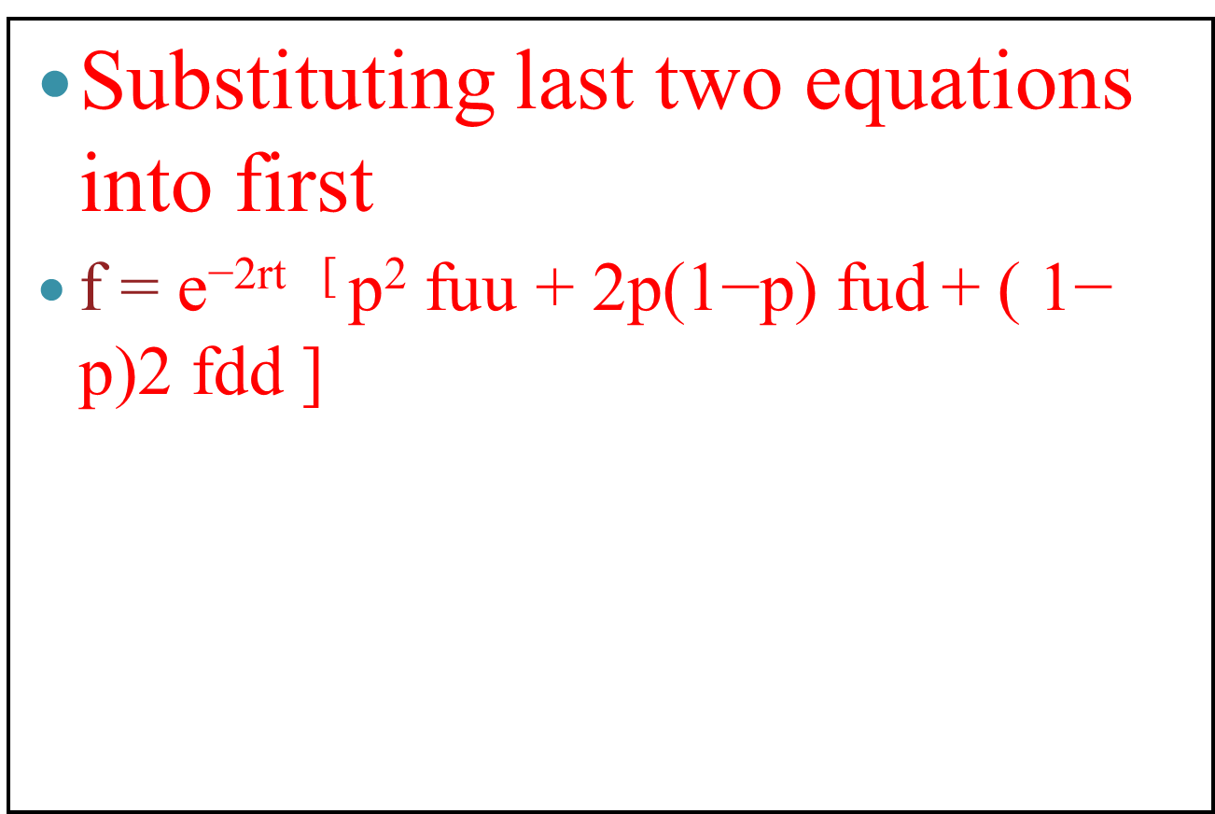
The Two-Period Binomial Option Pricing Model
Substituting last two equations into first
f =$\text{e}\text{−}\text{2}\text{rt}\text{ [ }\text{p}\text{2} \text{fuu}\text{ + 2}\text{p}\text{(1−}\text{p}\text{) }\text{fud} \text{+ ( 1− }\text{p}\text{)2 }\text{fdd}$ ]

Slide 54
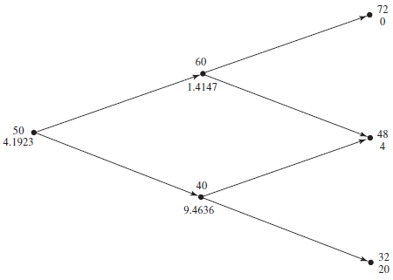
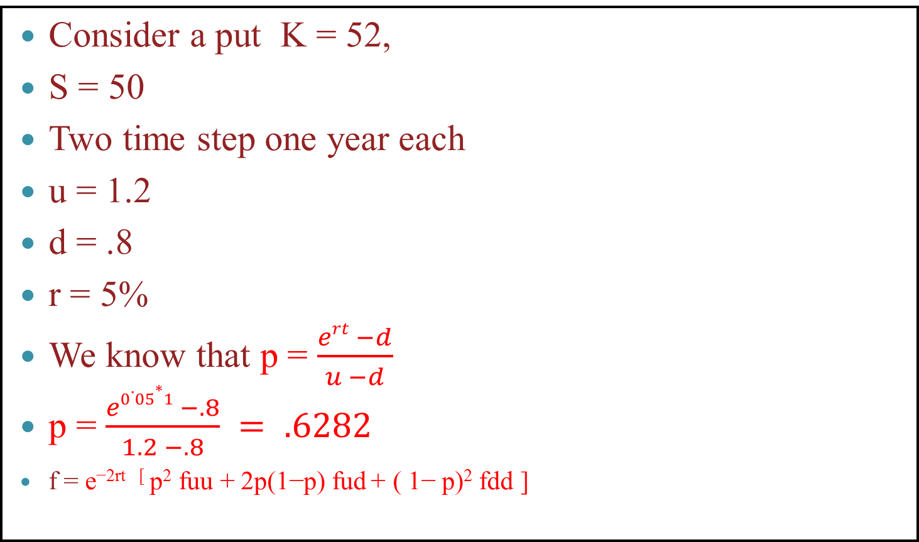
Example
Consider a put K = 52,
S = 50
Two time step one year each
u = 1.2
d = .8
r = 5%
We know that p = $\frac{ert −d}{u −d}$
p = $\frac{e0.05∗1 −.8}{1.2 −.8} = .6282$
f =$\text{e}\text{−}\text{2}\text{rt}\text{ [ }\text{p}\text{2} \text{fuu}\text{ + 2}\text{p}\text{(1−}\text{p}\text{) }\text{fud} \text{+ ( 1− }\text{p}\text{)2 }\text{fdd}$ ]

Slide 55
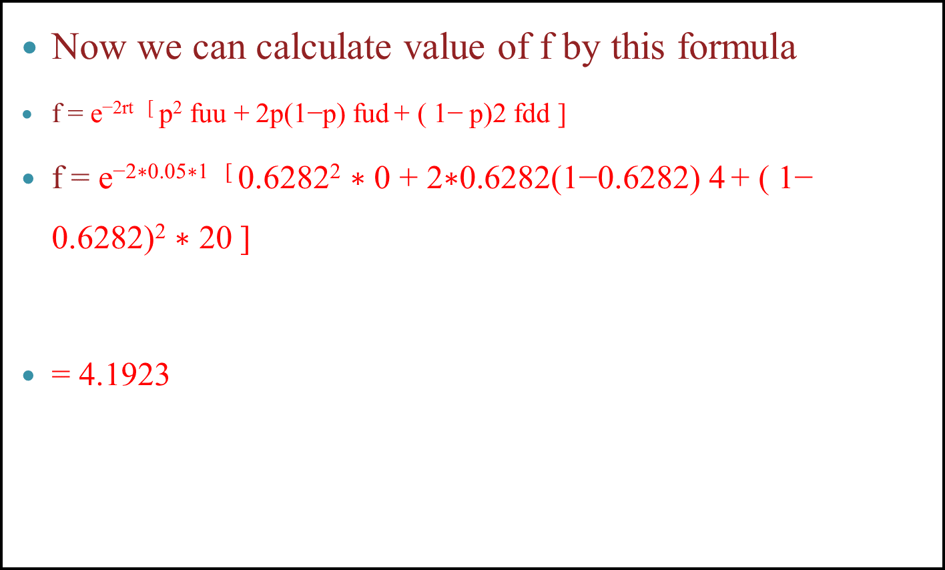
Example
Now we can calculate value of f by this formula
f =$\text{e}\text{−}\text{2}\text{rt}\text{ [ }\text{p}\text{2} \text{fuu}\text{ + 2}\text{p}\text{(1−}\text{p}\text{) }\text{fud} \text{+ ( 1− }\text{p}\text{)2 }\text{fdd}$ ]
f =$\text{e}\text{−2}\text{∗0.05∗1}\text{ [ }\text{0.6282}\text{2} \text{∗ 0}\text{ + 2}\text{∗0.6282}\text{(1−}\text{0.6282}\text{) }\text{4} \text{+ ( 1− }\text{0.6282}\text{)}\text{2} \text{∗ 20}$ ]
= 4.1923

Slide 56
Valuing the Options Using Excel

Slide 57
OPTION PRICEING
Black–Scholes model(BSM)

Slide 58
The Black-Scholes Option Pricing Model
The Black-Scholes option pricing model says the value of a stock option is determined by five factors:
S, the current price of the underlying stock.
K, the strike price specified in the option contract.
r, the risk-free interest rate over the life of the option contract.
T, the time remaining until the option contract expires.
σ, (sigma) which is the price volatility of the underlying stock.

Slide 59
The valuation formula
Assumption for the BSM for value of an option.
Short term interest rate is known and is constant.
The stock price follows a random walk and distribution of possible stock prices at the end of any finite period is log- normal.
Variance rate of return on stock is constant.
No dividend or other distribution.
Option is European.
No transaction costs.
Can borrow any fraction of the price of a security to buy it or hold it, at the short term interest rate.
No penalties on short selling.

Slide 60
The Black-Scholes Option Pricing Formula
The price of a call option on a single share of common stock is:
C = S*N(d₁) – K*e^{–r(T)}*N(d₂)
The price of a put option on a single share of common stock is:
P = Ke^{–r(T)} *N (–d₂) – S*N(–d₁)
d₁ and d₂ are calculated using these two formulas:

Slide 61
Formula Details
In the Black-Scholes formula, three common functions are used to price call and put option prices:
e^{-rt}, or exp(-rt), is the natural exponent of the value of –rt (in common terms, it is a discount factor)
ln(S/K) is the natural log of the "moneyness" term, S/K.
N(d1) and N(d2) denotes the standard normal probability for the values of d1 and d2.
In addition, the formula makes use of the fact that: N(-d₁) = 1 - N(d₁)

Slide 62
Example: Computing Prices for Call and Put Options
Suppose you are given the following inputs: S = $50
K = $45
T = 3 months (or 0.25 years)
s = 25% (stock volatility)
r = 6%
What is the price of a call option and a put option, using the Black-Scholes option pricing formula?

Slide 63
We Begin by Calculating d₁and d₂
Now, we must compute N(d₁) and N(d₂). That is, the standard normal probabilities.

Slide 64
Using the =NORMSDIST(x) Function in Excel
If we use =NORMSDIST(1.02538), we obtain 0.8474.
If we use =NORMSDIST(0.90038), we obtain 0.8160.
Let’s make use of the fact N(-d₁) = 1 - N(d₁).
N(-1.02538) = 1 – N(1.02538) = 1 – 0.8474 = 0.1526.
N(-0.90038) = 1 – N(0.90038) = 1 – 0.8160 = 0.1840.
We now have all the information needed to price the call and the put.

Slide 65
The Call Price and the Put Price:
Call Price = SN(d₁) – Ke^{–rT}N(d₂)
= $50 x 0.84741 – 45 x e^{-(0.06)(0.25)} x 0.81604
= 50 x 0.84741 – 45 x 0.98511 x 0.81604
= $6.195.
Put Price = Ke^{–rT}N(–d₂) – SN(–d₁)
= $45 x e^{-(0.06)(0.25)} x 0.19479 – 50 x 0.15259
= 45 x 0.98511 x 0.18396 – 50 x 0.15259
= $0.525.

Slide 66
We can Verify Our Results Using Put-Call Parity
Note: The options must have European-style exercise.
Verified.

Slide 67
Valuing the Options Using Excel

Slide 68
Valuation of Currency Options
European Call Option
C = Se^{-rf × T} × N(d₁) – Ke^{–r(T)} × N(d₂)
rf is the continuously compounded risk-free foreign currency interest rate
r is the continuously compounded risk-free local currency interest rate

Slide 69
Valuation of Currency Options
European Put Option
P = Ke^{–rT} × N(–d₂) – S × e^{-rf} ^{x} ^{T} × N(–d₁)

Slide 70
Que
Suppose USD =Rs. 50. (SPOT)
A 3-M option on USD has exercise price of Rs. 52. (K)
It has annual volatility of 15%.
Continuously compounded risk-free rupee rate is 8% p.a. (r)
Dollar rate is 3% p.a. (rf)
What would be its price as per Black Scholes model, if it is an European Call?

Slide 71
Answer

Slide 72
Using the =NORMSDIST(x) Function in Excel
NORMSDIST(-0.31878), we obtain 0.374948
NORMSDIST(-0.39378), we obtain 0.346873 .
Let’s make use of the fact N(-d₁) = 1 - N(d₁).
N(-d₁) = 1 – 0.374948 = 0.625052
N(-d₂) = 1 – 0.346873 = 0.653127 .

Slide 73
The Call Price and the Put Price:
Call Price = S x e^{-rf x T} x N(d₁) – K x e^{–r(T)} x N(d₂)
= 50 x 0.992528 x 0.374948 – 52 x 0.980199 x 0.346873
= 49.6264 x 0.374948 – 50.97033 x 0.346873
= 0.927086.
Put Price = Ke^{–rT} x N(–d₂) – S x e^{-rf} ^{x} ^{T} x N(–d₁)
= 52 x e^{-(0.08)(0.25)} x 0.653127 – 50 x e^{-(0.03)(0.25)} x 0.625052
= 52 x 0.980199 x 0.653127 – 49.6264 x 0.625052
= 2.271017.

Slide 74
Que 1
Suppose a stock, trading at Rs. 20, has annual volatility of 15%. A 3-month option on that stock has exercise price of Rs. 17. Continuously compounded risk-free rate is 8% p.a. What would be its price as per Black Scholes model, if it is an European Call?

Slide 75
New Case
In the next few days we use as an example the position of a financial institution that has sold for $300,000 a European call option on 100,000 shares of a non-dividend paying stock.
S₀ = 49,
K = 50,
r = 0.05 or 5%,
σ = 0.20 or 20%,
T = 0.3846 or 20 weeks,
Exp return = 0.13
The Black-Scholes-Merton price of the option is about $240,000 (that is, $2.40 for an option)

Slide 76
The Black-Scholes Option Pricing Formula
The price of a call option on a single share of common stock is:
C = S*N(d₁) – K*e^{–r(T)}*N(d₂)
P = Ke^{–r(T)} *N (–d₂) – S*N(–d₁)

Slide 77
BSM
Call option premium is = 2.40

Slide 78
BSM
Suppose market price of call option is 3.00

Slide 79

BSM

Slide 80
NAKED Strategy

Slide 81
NAKED Strategy
A trading strategy where the seller of an option contract does not own any, or enough, of the underlying security to act as protection against adverse price movements.
Naked trading is considered very risky since losses can be significant.
“An options trader could sell, for example, call options with a strike price of $50. If the stock's price falls to $20 or $30 on bad news, and the option is naked”. So option holder will suffer losses.

Slide 82

NAKED POSITIONS
The financial institution has therefore sold the option for $60,000 more than its theoretical value.
But the problem of hedging the risks.

Slide 83
NAKED POSITIONS
A naked position is very dangerous.
For example, if after 20 weeks the stock price is $60, then financial institution have to take loss of 700000$

Slide 84
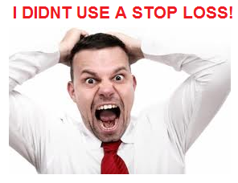
COVERED POSITIONS

Slide 85
COVERED POSITIONS

Slide 86

Sirr by buying 100,000 shares as soon as the option has been sold we can earn 400000$
And sir I think this is the best strategy ever 100% profit.

Slide 87
COVERED POSITIONS
An options strategy whereby an investor holds a position in an option and cover position on that same asset in an attempt to generate increased income from the asset.
Like “ Writes (sells) call options and holds a long position in an asset on that same asset.”

Slide 88
COVERED POSITIONS
Okay means we should take cover positions?
Lets see sold 100000 call option we receive 300000$ and same time we buy 100000 shares @ 49.
If after 20 weeks the stock price is $60
We have to sell 100000@50 means 100000 profit
And 300000 from call premium
Total profit will be 400000$
Seems to be very nice deal

Slide 89
COVERED POSITIONS
Buy, If after 20 weeks the stock price is $30
Then no one will take your shares @ 50
M2M loss will be 2000000 minus 300000 (1700000$)
1700000$ loss

Slide 90
Sirr why don’t you buying one unit of the stock as soon as its price rises above K and selling it as soon as its price falls below K
By doing this, if at the end price of stock is 60$ then we have 100000 shares and if price is 30 $ then we don’t have any shares.
And we can end up with at least 300000$

Slide 91
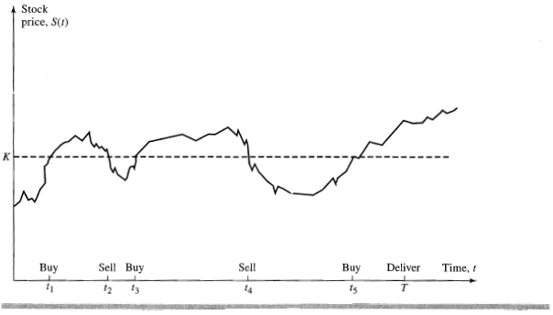
Stop loss strategy
Here buy and sell are very few.
Just think in real, market fluctuates infinite time. So we have to buy and sell infinite time. So again loss.

Slide 92

The answer is…
DELTA HEDGING

Slide 93


That’s all for the DAY!!!

